Slide 1

Research Data Management
Makaba Macanda & Ronell Bezuidenhout

Slide 2
Introduction/Background
Unisa Library embarked on a Research Data Management project 2010
Mandated by the Library Senate Committee.
Ethics policy reviewed to incorporate RDM

Slide 3
Approach/Model
Managing as a Systems project
  Determined need and readiness with survey of researches (2011)
  Self learning and networking on RDM including systems and workflows – 2011 +
  System requirements and specifications – 2013-4
  Policy drafting
  Exploring roles of user-end (internal advocacy)

Slide 4
Scope
The Library project scope covers the digitization and preservation of raw research data of all Unisa researchers (staff, adjuncts, visitors and students) engaged in research in all disciplines, irrespective of format and location

Slide 5
2011
The library conducted and completed a survey report on Research Data Management practices at Unisa https://www.surveymonkey.com/s/BGX9L2N
- 70% of the respondents were willing to submit data and 30 % not and below are some of their reasons why not:-
- Confidentiality was considered when planning the research
- Sensitivity and ethical concerns

Slide 6
2012
The focus of the project was to identify researchers per college who would participate by giving their raw research data for the Library
In an effort to facilitate the required ICT infrastructure for Research Data Management, a discussion was held with Unisa ICT. We have submitted the High Level Business Requirements to ICT

Slide 7
Business requirements:
Workspace
Preservation of data = Short-term
= Long-term
3. Retrieval/Discovery/Dissemination
4. Security and access control
5. Management information
6. General

Slide 8
2013
The focus was to continue to be on ICT infrastructure for Research Data Management and to test the software and system
The ICT Business Analyst suggested that OpenText Collection Server might be a solution

Slide 9
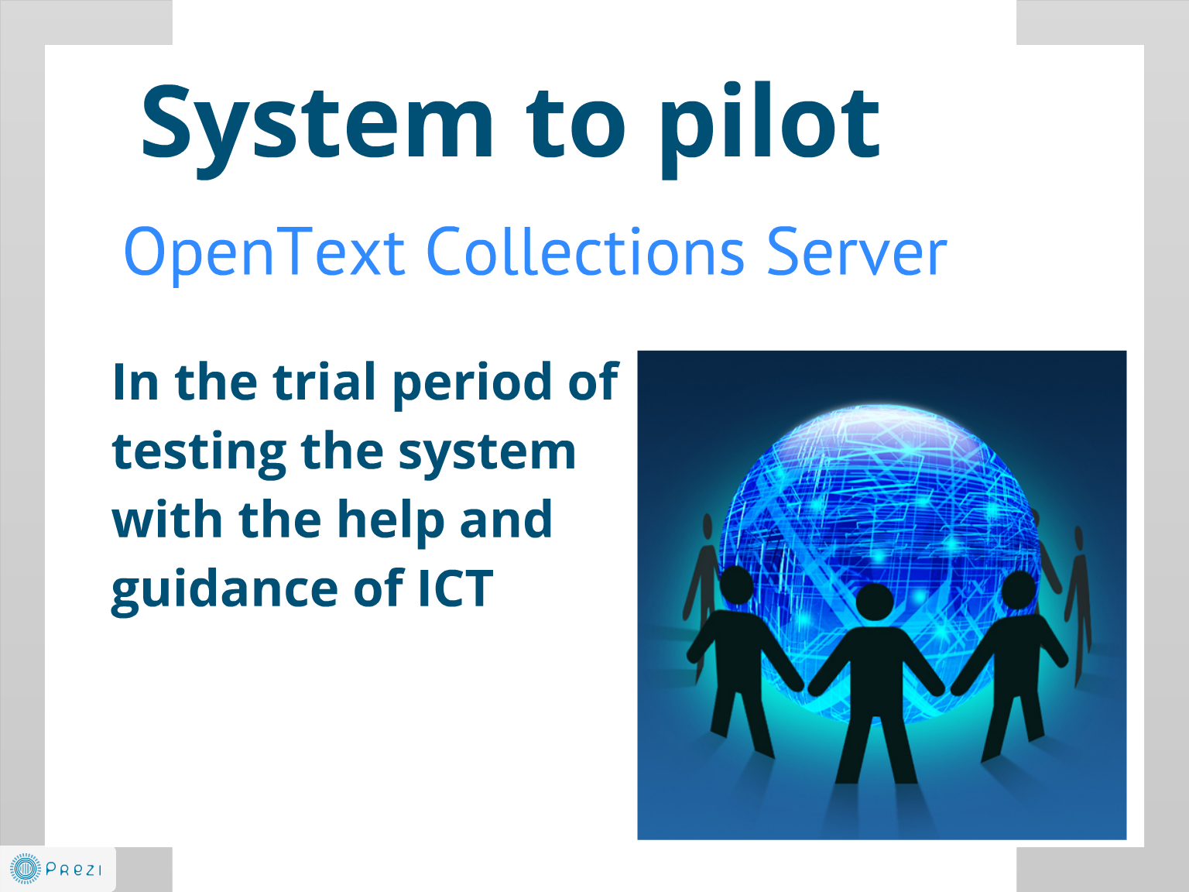

Slide 10
Activities so far…
Capacity building and training
  NEDICC workshop (CSIR)
  4th and 5th African digital scholarship conference (CSIR and UKZN)
  HELIG Webinar
  LIASA HELIG presentation
  Tshwane Public Libraries presentation
  HSRC visit
  African Library Summit

Slide 11
Activities continued…
Report to management:
Senate reports = March
= September
MoU with Alberta University signed

Slide 12
2014 and beyond…
Research Symposium 2014
Develop policy and guidelines
Do some more testing on other systems
More capacity building
Advocacy
Training

Slide 13
Conclusion
Project not an easy road
- Learning on the move
- No training available locally
    Financial implication
    Time
- Interdependencies
- Technologically intensive
- Dedicated human capital to the project

