Slide 1

RDM activities at UWC
NeDICC meeting, 18 February 2016

Slide 2
Outline
Disclosure and UWC context
Overview of our exposure to RDM
What have we done?
Challenges
Questions

Slide 3
Disclosure and UWC context
No recurring RDM activities – aspirational
New UWC executive leadership positions the institution
(Rector, DVC Research and Innovation, DVC Academic, Registrar, Director of Research)
UWC vision of becoming a research intensive university
Now in the top tier of SA HEIs - playing catch-up
Under-resourced, putting systems in place
Alignment in the Research division offers improved synergy

Slide 4

Overview of exposure to RDM – becoming psyched!

Slide 5
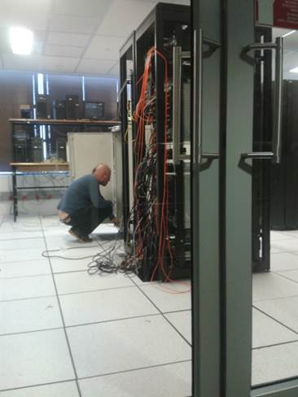
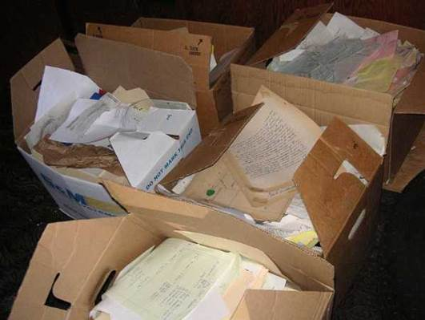
What have we done? - 1
investigate two research units’ data practices and attitudes
Bioinformatics: computationally intensive; scripts to read and visualise data | Poverty and Agrarian studies: multidisciplinary research area; diverse data sources and formats

Slide 6
What have we done? - 1
investigate two research units’ data practices and attitudes
 | Poverty and Agrarian Studies | Bioinformatics
Focus | Marginalised livelihoods; security of rights to land and water | Assembly of genomes; analyse mutations associated with diseases
Storage | Personal devices | Server room
Organisation | Inadequate methods for versioning | Creating databases and scripts
Documentation | Not sure that others would understand | Unable to replicate findings; Difficulty following their own notes
Formats | Multiple formats, including handwritten notes | Protein sequences (DNA expressions). Working with multiple scripts for analysing
Loss of data | Deactivated user accounts; corrupt storage | Lost computer code
Sharing | Unrestricted; but no time to prepare; don’t know where to deposit | Variable access control; human tissue prevents sharing
Budgeting | No | Starting
Services | Across data life cycle | Not needed

Slide 7

What have we done? -2
A group of library staff takes a month-long online course in RDM
Upon completion of this course, an academic librarian could assist users with data management plans, provide them with a variety of long-term options, and perform educational outreach to the data producers in their community.
Librarians were able to see the links with information literacy and OA initiatives.

Slide 8
What have we done? -3
Engage with others on campus
Meeting with IT managers – July 2015
Campus workshop – August 2015
IOP and R&I Strategy consultations – 2015 ongoing
“At UWC the vision is to develop a university funded e-Research Centre devoted to supporting data management. The mission of the centre is to promote e-research at UWC, by providing for outreach and education on e-research within UWC, maximizing funding opportunities, pooling expertise and sharing resources, bringing together all users and potential users, encouraging collaboration and multidisciplinary research groups, and enabling participation of UWC research in national and international initiatives” (Former DVC: Research, August 2015)

Slide 9
Challenges
Uncertainty and variability in the relationship with IT and Research offices (Pinfield, 2014)
Disconnect between roles envisioned by library directors and liaison librarians (Tenopir, 2014)
Still at this point only 25 of the 63 libraries addressed data services in their strategic plans (Saunders, 2015)

Slide 10
Questions
Do we continue with our own ground level activities to equip ourselves to roll out generic and discipline specific RDM support?
Continue with efforts to mainstream RDM in a coordinated way on campus?
What have been some of the successful strategies pursued by others?

Slide 11
Allison Fullard afullard@uwc.ac.za
Thanks to colleagues for input Comments?
Pinfield, S., Cox, A.M. and Smith, J. (2014). RDM and libraries: relationships, activities, drivers and influences. PLOS One, 9(12)
Saunders (2015). Academic library strategic plans: top trends and under-recognised areas.
J. of Academic Librarianship,. http://dx.doi.org/10.1016/jacalib.2015.03.011
Tenopir, C., et al. (2014). RDM services in academic research libraries and perceptions of librarians. Library & Information Science Research, 36: 84-90.

